Slide 1
Hiring Process Analysis Report
Rukmini Poojari

Slide 2
Objective
The objective of this presentation is to analyze and summarize the hiring process , based on historical hiring data. This analysis will provide insights into:
Gender Distribution: Understanding the ratio of male and female hires.
Salary Trends: Determining the average salary offered to hires and analyzing the salary distribution.
Departmental Distribution: Identifying which departments have the highest/lowest number of hires.
Position Tier Analysis: Analyzing the distribution of positions across various tiers or levels.
Outliers and Patterns: Identifying any outliers or significant trends that may impact hiring strategies.
The purpose of these insights is to:
Optimize the hiring process.
Ensure a fair and balanced hiring approach.
Improve salary benchmarks and distribution across departments.
Help leadership make informed decisions for future hiring strategies.

Slide 3



Gender Distribution of Hires
Objective: Find the number of males and females hired by the company.
Steps:
Open the dataset in Excel.
Apply a filter:
Select the entire data table (Ctrl + A).
Go to the Data tab in the ribbon and click Filter.
Click the filter arrow on the Status column and select only "Hired."
After filtering, count the number of males and females:
In an empty cell, use the COUNTIF function to count how many "Male" and "Female" were hired.
For males: =COUNTIF(D:D, "Male")
For females: =COUNTIF(D:D, "Female")
This will give you the count of hired males and females.

Slide 4

Average Salary Offered
Objective: Calculate the average salary offered to hires.
Steps:
Ensure that the filter for "Hired" candidates is still applied (from step A).
Select an empty cell and use the AVERAGE function:
Type =AVERAGE(G:G) where G:G represents the "Offered Salary" column.
Press Enter to calculate the average salary

Slide 5
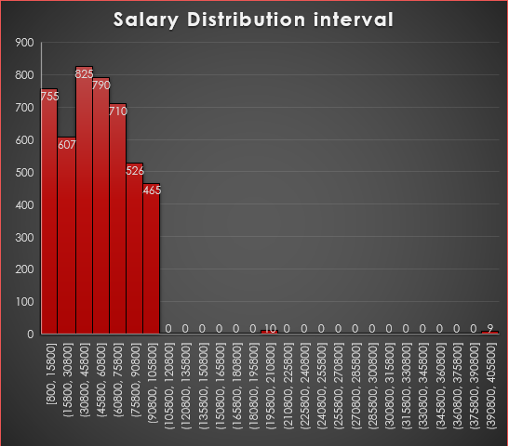
Salary Distribution (Class Intervals)
Objective: Create class intervals for the salaries to understand the salary distribution.
Steps:
Select the Offered Salary column.
Go to the Insert tab, and in the Charts section, click Histogram.
To adjust the class intervals:
Right-click the X-axis on the chart and choose Format Axis.
In the side panel, set the "Bin width" under "Axis Options." For example, if you want intervals of 15,000, set the Bin Width to 15000.
The histogram will now show the salary distribution based on the specified intervals.

Slide 6
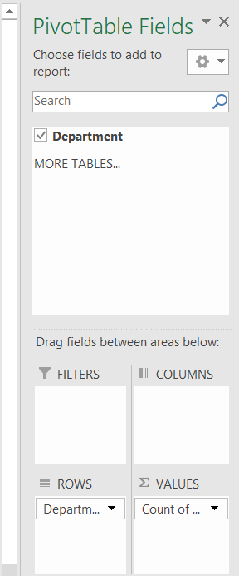
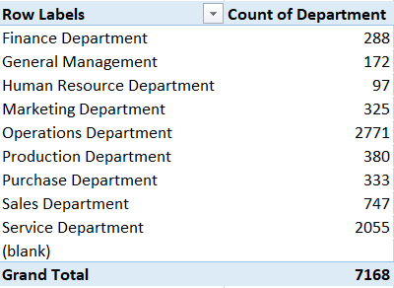
Departmental Analysis (Proportion Visualization)
Objective: Show the proportion of employees in different departments.
Steps:
Select the Department column.
Go to the Insert tab, click PivotTable, and choose to place the Pivot Table on a new worksheet.
In the PivotTable field list:
Drag the Department field to both Rows and Values.
This will give you the count of people in each department.
To create a chart:
Select the Pivot Table, go to the Insert tab, and choose Pie Chart or Bar Graph.
Customize the chart as needed.

Slide 7
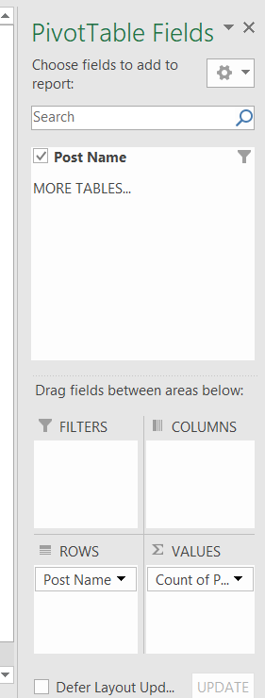
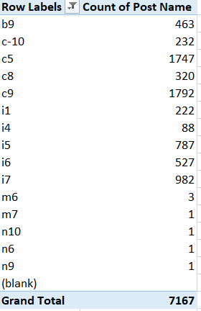
Position Tier Analysis (Chart for Position Levels)
Objective: Analyze the distribution of different position tiers in the company.
Steps:
Select the Post Name column.
Go to the Insert tab and click PivotTable, and place it on a new worksheet.
In the PivotTable field list:
Drag Post Name to both Rows and Values to get the count of each position.
Create a chart:
Select the Pivot Table and go to the Insert tab.
Choose a Bar Chart or Pie Chart to visualize the position tiers.
Customize the chart to make it more informative.

Slide 8
Project Description
Overview: This project aims to analyze the hiring process data of [Your Company Name] to uncover key insights that will help improve future hiring decisions. The data covers various aspects such as gender distribution of hires, salary trends, departmental hires, and the tier-level positions. Through this analysis, the company seeks to streamline the hiring process, ensure fair practices, and optimize salary structures.
Objectives:
To understand the gender distribution of hires.
To calculate the average salary offered and analyze salary distribution.
To visualize the distribution of hires across departments.
To analyze the hiring patterns for different position tiers.
To provide actionable recommendations to improve the hiring process.

Slide 9
Approach
Step-by-step Approach:
Data Cleaning and Preprocessing:
  Checked for missing values and handled them using appropriate methods (e.g., removing rows with missing data or filling them with averages).
  Clubbed certain categories where necessary to simplify the analysis (e.g., grouping similar job titles).
  Detected and handled outliers that could skew salary and hiring trends (e.g., extreme salary values).
Data Analysis
Gender Distribution: Used Excel filters and COUNTIF functions to determine the number of males and females hired.
Salary Analysis: Calculated the average salary using the AVERAGE function and created a histogram to show salary distribution.
Departmental Analysis: Used a Pivot Table to count the number of hires in each department and created a bar chart for visualization.
Position Tier Analysis: Visualized the distribution of positions across various tiers using a Pivot Table and corresponding bar graph.

Slide 10
Outlier Detection and Handling:
Outliers were detected by plotting salary data in a histogram. Outliers were either removed or adjusted based on the overall impact on the analysis.
Visualization:
Created visual charts (bar charts, pie charts, histograms) in Excel to represent findings effectively.
Tech-Stack Used
Microsoft Excel 2016:
  Data Cleaning: Filtered out irrelevant or missing data points.
  Data Analysis: Used functions such as COUNTIF, AVERAGE, and Pivot Tables for gender, salary, departmental, and tier-level analysis.
  Visualization: Created bar charts, pie charts, and histograms to visualize trends and patterns.
Additional Tools: None

Slide 11
Insights
Gender Distribution:
  A slight majority of hires were male, indicating a gender imbalance that could be addressed in future hiring strategies.
Salary Trends:
  The average salary offered by the company was $[49983.03 ].
  A significant portion of employees falls within the $40,000 - $60,000 salary range, with a few outliers on the higher end of the salary spectrum.
Departmental Distribution:
  The Operations and Sales departments had the highest number of hires, while departments like IT and HR had fewer.
  This trend suggests higher turnover or greater hiring needs in Operations and Sales.
Position Tier Analysis:
  Most hires were in junior-level positions (e.g., Tier C5), while senior-level roles (e.g., Tier I4) accounted for a smaller percentage.
  This indicates that the company may be focusing more on entry-level hiring.
Outliers:
  Certain outliers in salary, particularly in executive positions, were identified and adjusted to avoid skewing the overall salary trend.

Slide 12
Result
Successfully identified gender imbalances in the hiring process, highlighting areas where the company could improve diversity.
Provided a clear picture of salary trends, allowing for more informed decisions on salary benchmarks across departments.
Showed which departments have the highest hiring needs and which levels (tiers) are most frequently hired, guiding future recruitment focus.
Gained insights into potential outliers in salary data and suggested steps to correct or consider them in future planning.
Conclusion: The project provided valuable insights into the company's hiring process and has contributed to a deeper understanding of how hiring trends can impact overall organizational effectiveness. This analysis can serve as a foundation for optimizing recruitment strategies, ensuring diversity, and standardizing salary structures in the future.

Slide 13
THANK YOU !!

